Slide 1


Slide 2

Deploying and managing Office 365 ProPlus in a Modern World
Ronni Pedersen
Microsoft MVP: Enterprise Mobility
APENTO
@ronnipedersen

Slide 3


Ronni Pedersen
Cloud Architect / Partner
APENTO
Microsoft MVP: Enterprise Mobility (11 years)
Founder: System Center User Group Denmark
Microsoft Certified Trainer
Contact Me
Twitter: @ronnipedersen
Blog: https://www.ronnipedersen.com/
Mail: rop@apento.com
Phone: +45 2085 9452
About me...

Slide 4

Agenda
Office 365 ProPlus vs. Office 2019
Office Customization Service
Modern Deployment Methods
Migration to Office 365 ProPlus
Network Delivery Optimization
Roadmap
Summary
@ronnipedersen

Slide 5
Office 2019
Office 365 ProPlus
Limited in-client collaboration
Limited cloud integration
Static features; subset of ProPlus
Security and quality updates only
One PC per license
Real time co-authoring, @mentions etc.
Cloud and AI powered features
Richer and better every month
Security that evolves with threats
5 PCs/macs + 5 tablets/mobile + web
@ronnipedersen

Slide 6
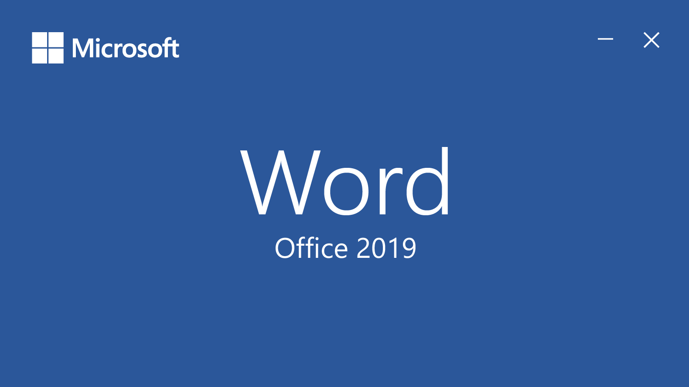
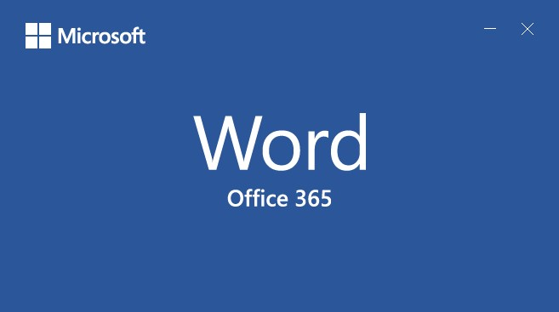
Spot the difference
Office 2019 is a one-time purchase that does not receive feature updates.
Office 365 is a subscription-based offering that receives feature updates.
@ronnipedersen

Slide 7
Office Supportability through 2020
CY 2018
CY 2019
CY 2020
CY 2021
April
July
Oct
Jan
April
July
Oct
Jan
April
July
Oct
Jan
Office 2010 in extended support
Office 2013 in extended support
Office 2016 in mainstream support
Office 2019 (in mainstream support)
O365 ProPlus (in mainstream support)
@ronnipedersen

Slide 8
Office 365 System Requirement Changes for 2020/2023
Office desktop clients:
PC and Mac
Outlook, OneDrive for Business, Skype for Business, Word, Excel, PowerPoint and OneNote
In 2020... Only client versions in mainstream support can access Office 365:
Office 365 ProPlus
Office/Mac 2019
New: Office 2016 (until 2023)
O365 services:
Exchange Online
SharePoint Online
Skype for Business
The O365 services will BLOCK the Office clients not meeting this new requirement
Note: Until Oct 13 2020, the Office clients (2010, 2013) can still connect to Office 365 services. Update: Office 2016 is now supported to October 2023
@ronnipedersen

Slide 9
Office 2019 powered by Click-to-Run
Legacy deployment
Modern deployment
MSI is almost two decades old
Introduced in 1999 with Office 2000
Capable platform designed for media-based install
C2R already used by hundreds of millions of devices worldwide
Consumer and enterprise subscription users
Powerful platform designed for internet install, update, and upgrade
@ronnipedersen

Slide 10
Office 2019 powered by Click-to-Run
.
.
Updates
Manageability
Licensing
Upgrades
Always up to date and secure
Predictable, cumulative monthly updates
Full management control and capabilities
Unified set of tools
Per-device
KMS and MAK activation
Supports disconnected devices
Easy upgrade to Office 365
Move when ready
@ronnipedersen

Slide 11

ProPlus is Enterprise Ready
Capability | C2R | MSI
Local installation
VDI & RDS support
Automated Deployment
Selective Application Installation
Language pack management
Update management
Customize Application Settings
Object Model/Add-in Extensibility
Group Policy Support
Cloud installation
Automatic Update
Native ConfigMgr & Intune integration
Cloud Policy support
User based licensing
Telemetry
Click-to-run Additional benefits
Always up to date
Cloud installation
Automatic Update
Native integration with Configuration Manager & Intune
Required & Self Serve
Cloud Policy Support
AAD joined
Non-MDM managed
@ronnipedersen

Slide 12
Office Customization Service
Office Customization Tool - config.office.com
@ronnipedersen

Slide 13

config.office.com
Office Customization Tool
Web based deployment configuration
Automatic upgrade from MSI
User preferences
Configuration Manager 1806
Integrated Office Customization Tool experience
Office Customization Service
A new service providing the source of truth for the Office Customization Tool, Configuration Manager and Intune
@ronnipedersen

Slide 14

config.office.com
Capability
Export XML
Import XML
Create Install configurations
Standalone product support
Channel & Version support
Language Pack support
MatchOS support
CDN Fallback support
Automatic upgrade
Configure user preferences
Create language only configurations
Create Uninstall configurations
Prebuilt configurations
Powered by the Office Customization Service
Latest C2R deployment features
Built by the Office team
Supported by Microsoft
Supports integration with 3rd party management tools
@ronnipedersen
On the roadmap for future improvement

Slide 15

DEMO
config.office.com
@ronnipedersen

Slide 16
Deploying Office 365 ProPlus
with Microsoft Intune
@ronnipedersen

Slide 17
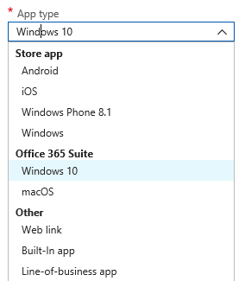
Software Deployment with Intune
The following apps are easy to deploy:
Microsoft Office 365 ProPlus
Apps from Microsoft Store for Business/ Public store
Universal Apps
Web links
MSI with a single file (LOB)
New Preview feature: Win32 App Deployment
EXEs
MSIs with multiple files
@ronnipedersen

Slide 18
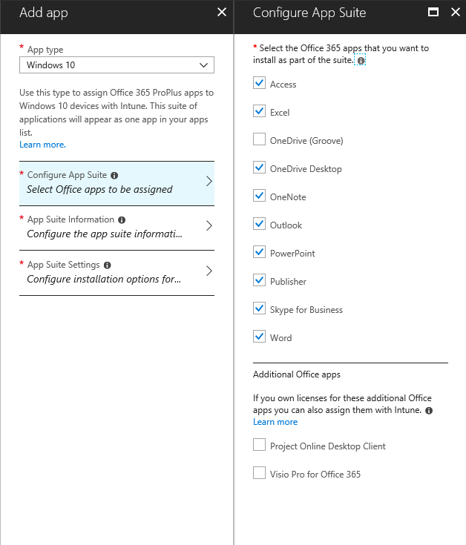
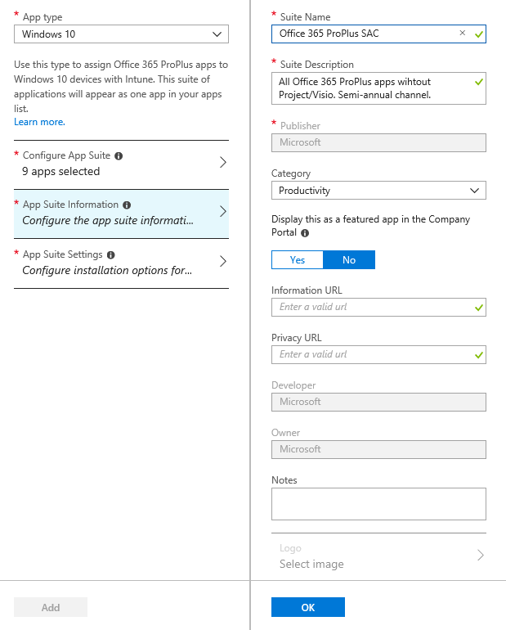
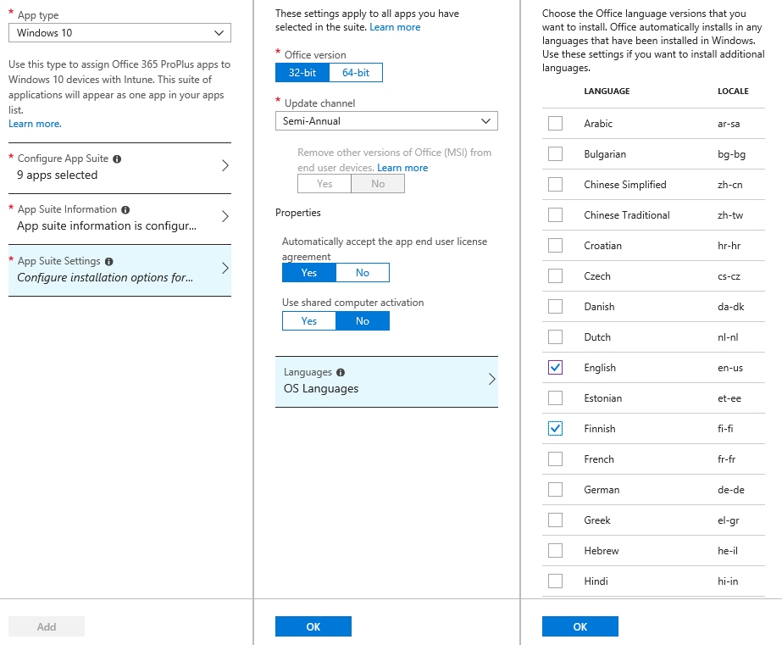
Deploying Office 365 ProPlus

Slide 19
DEMO
Deploy Office 365 ProPlus
using Microsoft Intune
@ronnipedersen

Slide 20
Deploying Office 365 ProPlus
with Configuration Manager and the
Office Customization Service
@ronnipedersen

Slide 21
Old School Deployment Process
Create the configuration
1
Download Office Deployment Tool (ODT) from Microsoft Download Center
Office CDN
2
ODT
Build the configuration XML
Source files
Deploy the configuration
Internet
3
Download source files from Office CDN
4
Distribution Points
configuration
Run install on client machines
Client devices
local source

Slide 22

Issues with Office Management in ConfigMgr
Packaging Method
Very laborious for admins
Manually generate and maintain XMLs
Download source files from the Office CDN
Use Office Deployment Tool (ODT) to create and deploy Office via ConfigMgr
Application Method through O365 Client Wizard
New features only ship every 4 months
Tied to ConfigMgr’s release cadence
Example: Language pack management
@ronnipedersen

Slide 23
Improvements in Configuration Manager
Office Customization Tool – https://config.office.com/
Integration with the Office Customization Services
Single cloud based Office configuration service for a better experience while deploying Office
Baked into the existing ConfigMgr Office deployment wizard
Receive updates and new features immediately without having to wait for the next release of Configuration Manager to manage new features
@ronnipedersen

Slide 24
DEMO
Deploy Office 365 ProPlus
using Configuration Manager
@ronnipedersen

Slide 25
Migration and upgrade to Office 365 ProPlus
@ronnipedersen

Slide 26
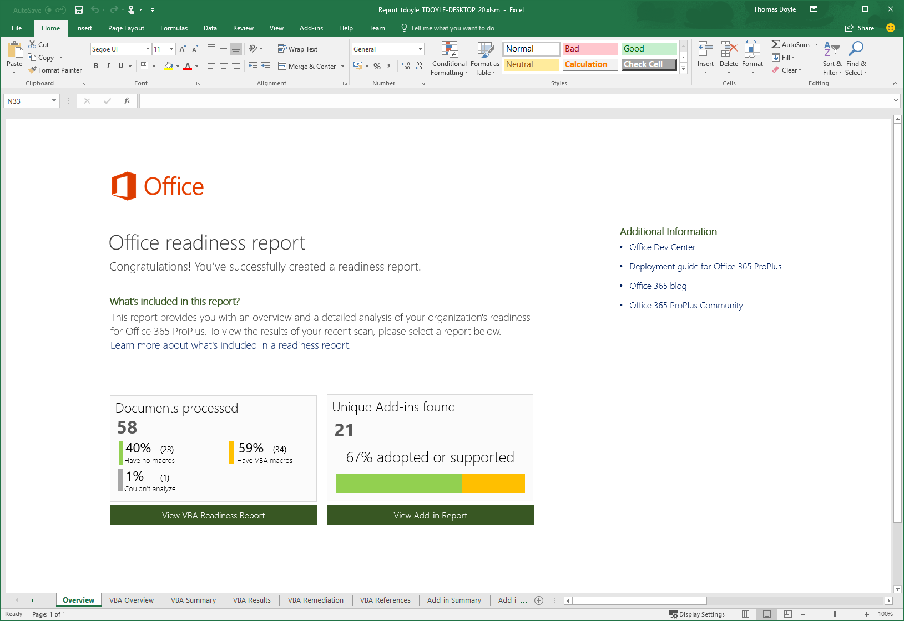
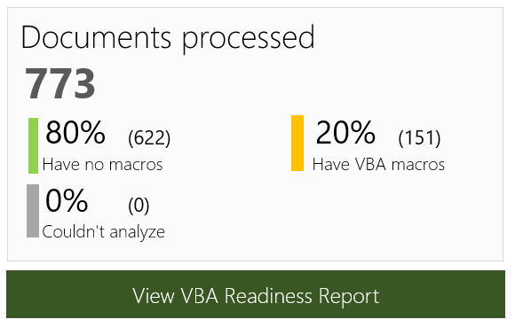
Office Readiness Toolkit
http://aka.ms/ReadinessToolkit
Assess upgrade readiness across devices in your organization
Creates an Excel report with:
Macro summary Total files, files with macros
Add-in summary Total, adopted, supported
@ronnipedersen

Slide 27

Easy MSI upgrade
Remove older Office versions to provide a ‘clean slate’ for new Office
Retain user settings, preferences, documents
No separate steps – integrated part of Office install
Fully supported by Microsoft
@ronnipedersen

Slide 28

Office 2019: A bridge to Office 365
2019 to Office 365 easy upgrade when ready to move
2016 to Office 365 recommended upgrade
Office 2019
Office 2016
2016 to 2019 can be a step in the journey to Office 365
Office 2013
Office 2010
Office 2007
2007
2010
2013
2016
2019
The Future
Represents re-evaluation and update of settings, policies, compatibility testing, etc.
Release Years

Slide 29
Office 2019: A bridge to Office 365
2019 to Office 365 easy upgrade when ready to move
2016 to Office 365 recommended upgrade
Office 2019
Office 2016
2016 to 2019 can be a step in the journey to Office 365
Office 2013
Office 2010
Office 2007
2007
2010
2013
2016
2019
The Future
Represents re-evaluation and update of settings, policies, compatibility testing, etc.
Release Years

Slide 30
Office 2019: A bridge to Office 365
2019 to Office 365 easy upgrade when ready to move
2016 to Office 365 recommended upgrade
Office 2019
Office 2016
2016 to 2019 can be a step in the journey to Office 365
Office 2013
Office 2010
Office 2007
2007
2010
2013
2016
2019
The Future
Represents re-evaluation and update of settings, policies, compatibility testing, etc.
Release Years

Slide 31

Office 365 Upgrade
Moving from Office 2019 to Office 365 will be the easiest upgrade ever
Choose what method works best for you:
Languages, user settings and preferences are maintained
All Office 2016/2019 Group Policies still apply
Users can sign in before or after upgrade
Admin | User | Policy
Deploy Office 365 directly via ODT | Install Office 365 from portal | Use Group Policy to automatically move when ready
@ronnipedersen

Slide 32

64 bit Recommended
Office 2019 and Office 365 ProPlus
New installs default to 64-bit
No change to existing installs
Adding products will match existing
Recommended but not Required!
Test, Test, Test…
@ronnipedersen

Slide 33
Network Delivery Optimization
@ronnipedersen

Slide 34

Reducing network demands
Average monthly security update: 50 MB
Managed infrastructure
Deploy updates via local network internally
No client PC internet connection required
Windows 10 Delivery Optimization
Reduce internet consumption by 75% or more
No infrastructure overhead
@ronnipedersen

Slide 35
Improvements to Office 365 ProPlus Click-to-Run (C2R)
Download Size Reduction
95% Update Compliance within 7 days
Semi-Annual
Monthly
New Scheduled Task
Check updates daily instead of 3x per week
Daily check window from 4 hours to 12 hours to distribute load on network
Quality Updates (QUs) averaging 100MB
Feature Updates in monthly averaging under 150MB
Feature Update
Quality Update
Peer-to-Peer Downloads
C2R Proofing Tools
MSI-to-C2R Upgrader
Configuration Manager P2P
Windows 10 Delivery Optimization
Individual proofing tools available in C2R format
Built into Office Deployment Tool

Slide 36

Office 365 ProPlus and Office 2019
Supported Enterprise Deployment Scenarios
Cloud Managed | Locally Managed | Enterprise Managed
Management tool
File Share / DFS
Office CDN
@ronnipedersen

Slide 37
Cloud Managed Deployment
Initial Deployment
Office cloud
1
Download Office Deployment Tool from Microsoft Download Center
Office CDN
2
Build configuration file to update from the CDN
1
ODT
3
Push configuration files to client devices
5
Internet
Run setup from client device
4
Client downloads Office package and installs Office
steup.exe /configure command
4
5
2
3
ODT
configuration.xml
Updates
Client devices
Admin Client
Customer on-premises infrastructure
Note 1-way vs. 2-way communication arrows
@ronnipedersen

Slide 38
Locally Managed Deployment
Initial Deployment
Office cloud
Download Office Deployment Tool (ODT) from Microsoft Download Center
1
Office CDN
Download source files from the Office CDN
1
2
Build configuration.xml files to point the client to the local file distribution locations for install and update
ODT
3
Source Files
Internet
2
Push ODT, configuration.xml, and source files to file distribution locations
4
steup.exe /configure command
5
DFS 1
Run setup from the client device
DFS 2
3
5
DFS 3
6
4
ODT
configuration.xml
Client Client downloads Office package from network shares and installs Office
Client devices
Admin Client
6
File Distribution Servers
Updates
Customer on-premises infrastructure
Note 1-way vs. 2-way communication arrows
@ronnipedersen

Slide 39
Enterprise Managed Deployment
Initial Deployment
Office cloud
Download Office Deployment Tool from Microsoft Download Center
1
Office CDN
Download source files from the Office CDN
1
2
ODT
Build ConfigMan package using ODT, source files, and configuration.xml
Source Files
3
2
Push package to distribution points
4
Run package install from client machines, client runs ConfigMan package and installs Office
5
5
4
3
C2R1 package
Config Manager Packages
Updates
Client devices
Config Manager
Distribution Points
C2R2 package
Config Manager Server
Customer on-premises infrastructure
Note 1-way vs. 2-way communication arrows
@ronnipedersen

Slide 40
Managing Updates and Upgrades
@ronnipedersen

Slide 41
Alignment with Windows 10
Windows Semi-Annual Channel
(supported for 18 months)
1
1
Feature updates are released to the Windows Semi-Annual Channel every six months, around March and September.
March
September
March
Office Monthly Channel
2
Feature updates are also released in March and September to the Office Semi-Annual Channel (Targeted). The updates include feature updates from the Monthly Channel.
Office Semi-Annual Channel (Targeted)
(supported for 6 months)
2
March
3
September
March
Office Semi-Annual Channel
(supported for 14 months)
3
Four months after the Office update is released to the Semi-Annual Channel (Targeted), it is released to the standard Semi-Annual Channel.
July
January
NOTE: In addition to feature updates, both Windows and Office release frequent quality and security updates to all channels.
@ronnipedersen

Slide 42
Office 365 Upgrades/Updates
Office 365 ProPLus
Monthly Release (Target Release)
Semi-Annular Release (Target Release)
Follow changes on https://office.com/roadmap
User Voice for feedback https://office365.uservoice.com/
Release History / Changes: https://docs.microsoft.com/en-us/officeupdates/release-notes-office365-proplus
@ronnipedersen

Slide 43
Teams and OneDrive for Business
@ronnipedersen

Slide 44
OneDrive for Business
Deployment and Configuration
Silent Config
Known Folder Move
Files On-demand
Versions
https://support.office.com/en-us/article/new-onedrive-sync-client-release-notes-845dcf18-f921-435e-bf28-4e24b95e5fc0
OneDrive guide for Enterprises
https://docs.microsoft.com/en-us/onedrive/plan-onedrive-enterprise?_lrsc=4120c360-b94f-4343-898c-cf82e6efccc9
OneDrive guide for Small Businesses
https://docs.microsoft.com/en-us/onedrive/one-drive-quickstart-small-business
@ronnipedersen

Slide 45
DEMO
Configure OneDrive for Business using Microsoft Intune
@ronnipedersen

Slide 46
Microsoft Teams
Deployment
32-bit (https://aka.ms/teams32bitmsi)
64-bit (https://aka.ms/teams64bitmsi)
Adoption and Guides (www.successwithteams.com)
@ronnipedersen

Slide 47
DEMO
Deploy Microsoft Teams using Microsoft Intune
@ronnipedersen

Slide 48
Summary
@ronnipedersen

Slide 49
Modern Desktop Adoption
Gain insights
Windows Analytics
Office Readiness Toolkit
Set foundation
Windows 10
Office 365
Modern devices
Stay current
Phased deployments
Agile updates
Modernize IT
Windows Autopilot
Microsoft Intune
@ronnipedersen
Notes:
“…”
Key points to land
Text
Text
Text

Slide 50
Summary and take aways
Modern Desktop Deployment (aka.ms/howtoshift)
Success with Teams (www.successwithteams.com)
Get Office 365 ProPlus for the all the latest features
Get Office 2019 for users who cannot be cloud connected
@ronnipedersen

Slide 51

Thank you!
@ronnipedersen
© RONNIPEDERSEN.COM
51

Slide 52


